Slide 1


WebRTC
RFC 7540
HTTP/2 is here, let’s optimize!
or, why (some) yesterday's best-practices are today's HTTP/2 anti-patterns.
+Ilya Grigorik
@igrigorik

Slide 2
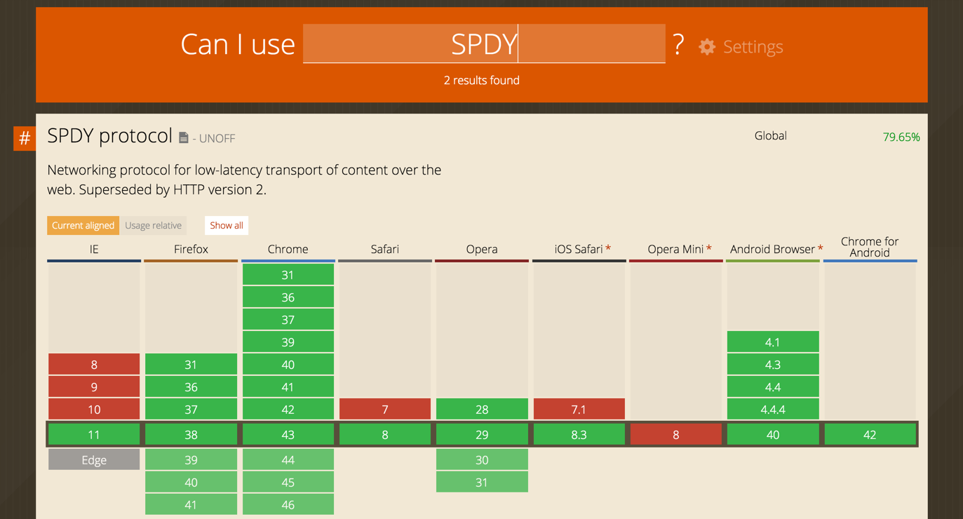


Slide 3
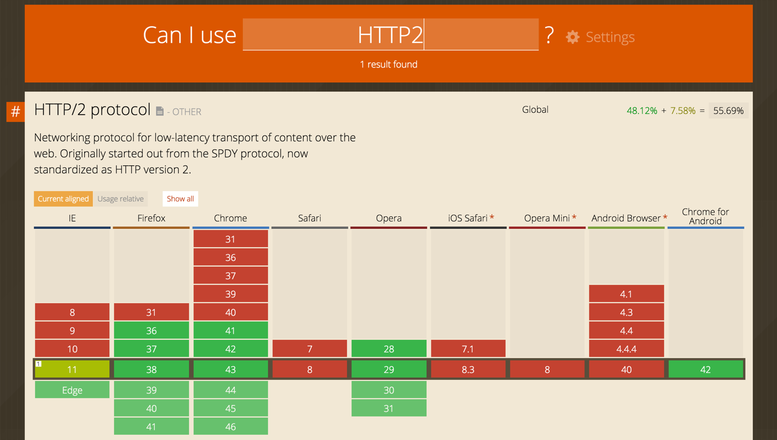


Slide 4
“9% of all Firefox (M36) HTTP transactions are happening over HTTP/2. There are actually more HTTP/2 connections made than SPDY ones. This is well exercised technology.”
Feb 18, 2015 - Patrick McManus, Mozilla
New TLS + NPN/ALPN connections in Chrome:
~27% negotiate HTTP/1
~28% negotiate SPDY/3.1
~45% negotiate HTTP/2
May 26, 2015 - Chrome telemetry

Slide 5
HTTP/2 is here.
HTTP/2 is well tested.
HTTP/2 is replacing SPDY.
See RFC7540 (HTTP/2) and RFC7541 (HPACK). HTTP/2 has already surpassed SPDY in adoption, and Chrome will deprecate SPDY (and NPN) in early 2016.

Slide 6
HTTP/2 in ~5 slides...
the what, why, and how behind the new protocol.

Slide 7
Improve end-user perceived latency
Address the "head of line blocking"
Not require multiple connections
Retain the semantics of HTTP/1.1
"HTTP/2 is a protocol designed for low-latency transport of content over the World Wide Web"

Slide 8
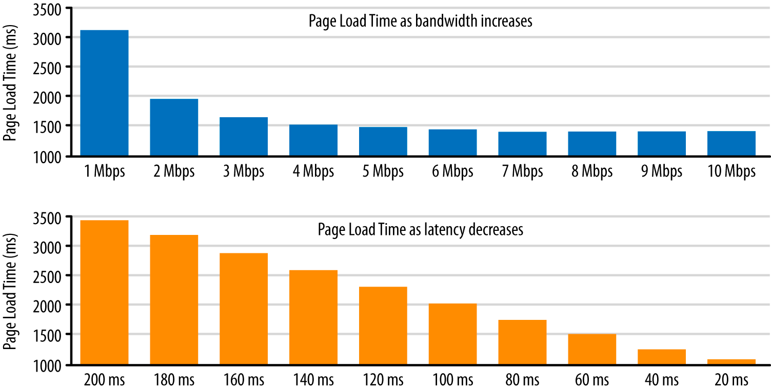
Latency vs Bandwidth impact on Page Load Time
Single digit % perf improvement after 5 Mbps
Linear improvement in page load time!
“To speed up the Internet at large, we should look for more ways to bring down RTT. What if we could reduce cross-atlantic RTTs from 150 ms to 100 ms? This would have a larger effect on the speed of the internet than increasing a user’s bandwidth from 3.9 Mbps to 10 Mbps or even 1 Gbps.” - Mike Belshe

Slide 9
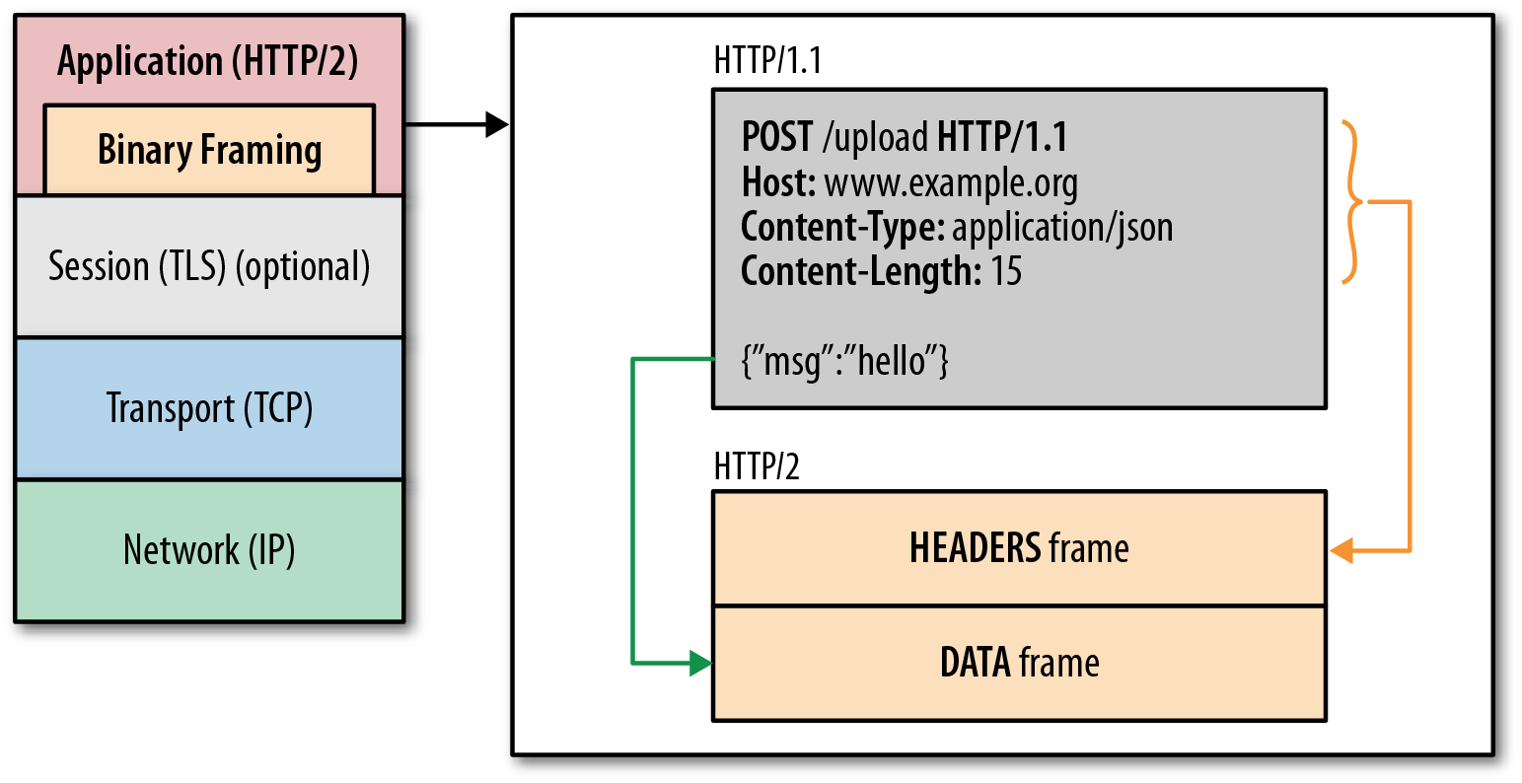
HTTP/2 in one slide…
One TCP connection
Request → Stream
Streams are multiplexed
Streams are prioritized
Binary framing layer
Prioritization
Flow control
Server push
Header compression (HPACK)

Slide 10
HTTP/2 binary framing 101
HTTP messages are decomposed into one or more frames
HEADERS for meta-data
DATA for payload
RST_STREAM to cancel
...
Each frame has a common header
9-byte, length prefixed
Easy and efficient to parse

Slide 11
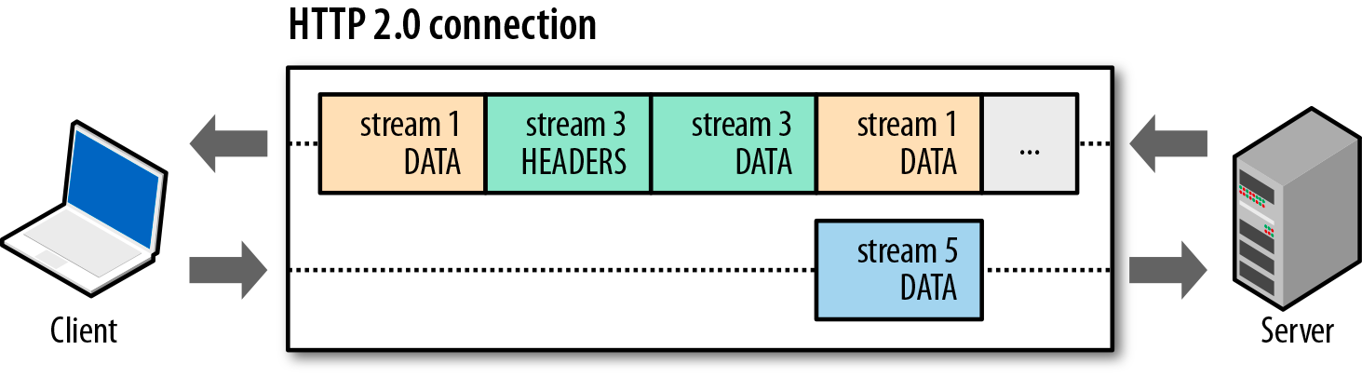
Basic data flow in HTTP 2.0...
Streams are multiplexed because frames can be interleaved
All frames (e.g. HEADERS, DATA, etc) are sent over single TCP connection
Frame delivery is prioritized based on stream dependencies and weights
DATA frames are subject to per-stream and connection flow control

Slide 12
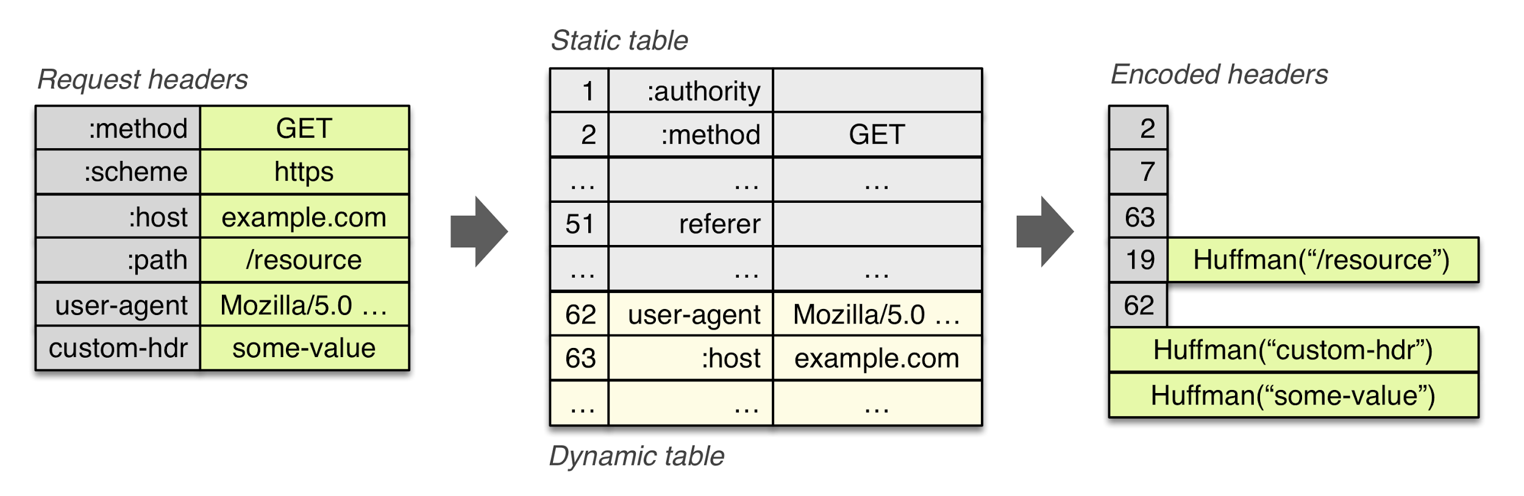
HPACK header compression
Literal values are (optionally) encoded with a static Huffman code
Previously sent values are (optionally) indexed
e.g. “2” in above example expands to “method: GET”

Slide 13

For a deep(er) dive on HTTP/2 protocol, grab the free book at the O’Reilly booth, or…
Read it online (free):
hpbn.co/http2

Slide 14
Optimizing (web) application delivery
let’s take a quick tour of our delivery pipeline...

Slide 15
Resource fetch, execution and processing, ….
Application
If/when lower layers fail, we’re forced to “optimize” at the application layer...
Parallelism, prioritization, protocol overhead, ...
HTTP
Handshakes, goodput, packet loss, ...
TCP
UDP
All things DNS (and QUIC :))
Link layer
(Ethernet, WiFi, LTE…)
RRC and radio delays, energy consumption, ...

Slide 16
Application
Reduce DNS lookups
Unresolved names block requests
HTTP
TCP
UDP
Link layer
✓ HTTP/1.x
✓ HTTP/2
Application
Reuse TCP connections
Connection are expensive - handshake latency, resource overhead, ...
HTTP
TCP
UDP
Link layer
✓ HTTP/1.x
✓ HTTP/2
Single connection!

Slide 17
Application
Use a Content Delivery Network
Page rendering is latency-bound (most of the time)
- lower roundtrip times are critical to optimize asset delivery
HTTP
TCP
UDP
Link layer
✓ HTTP/1.x
✓ HTTP/2
Application
Minimize number of HTTP redirects
Each redirect restarts the fetch process - cross-origin redirects are worst case: DNS, TCP, new HTTP request
HTTP
TCP
UDP
Link layer
✓ HTTP/1.x
✓ HTTP/2

Slide 18
Application
Eliminate unnecessary request bytes
Unnecessary metadata (e.g. headers) add up quickly
- 100+ requests, with a few KB each of headers… hundreds of KB’s!
HTTP
TCP
UDP
Link layer
✓ HTTP/1.x
✓ HTTP/2
HPACK helps...
Application
Compress assets during transfer
Bytes are slow and expensive to transfer... - GZIP offers 40-80% savings on most assets - easy win.
HTTP
TCP
UDP
Link layer
✓ HTTP/1.x
✓ HTTP/2

Slide 19
Application
Cache resources on the client
Redundant data transfers are… redundant!
- Cache-Control and ETag’s on each resource is a must.
HTTP
TCP
UDP
Link layer
✓ HTTP/1.x
✓ HTTP/2
Application
Eliminate unnecessary resources
Fetch what you need, bytes are expensive - Aggressive prefetching is expensive both on client and server.
HTTP
TCP
UDP
Link layer
✓ HTTP/1.x
✓ HTTP/2

Slide 20
Evergreen performance best-practices
Reduce DNS lookups
Reuse TCP connections
Use a Content Delivery Network
Minimize number of HTTP redirects
Eliminate unnecessary request bytes
Compress assets during transfer
Cache resources on the client
Eliminate unnecessary resources

Slide 21
Application
Limited parallelism
Parallelism is limited by number of connections
In practice, ~6 connections per origin
HTTP/1.x
TCP
UDP
Head-of-line blocking
Request queuing and delayed request dispatch on the client
Strict response ordering on the server
Link layer
High protocol overhead
Header meta-data is uncompressed
~800 bytes of meta-data per request, plus cookies

Slide 22
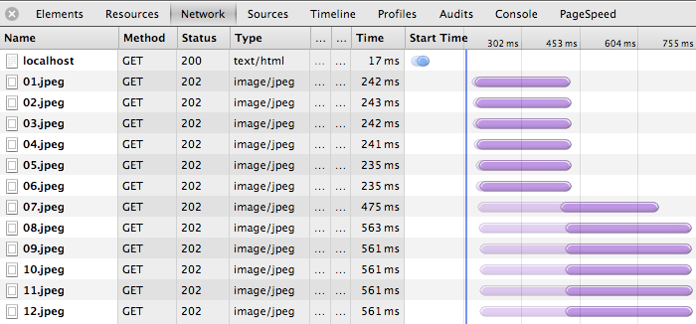
Parallelism is limited by number of connections
~6 parallel downloads per origin
Each connection incurs full TCP handshake
Each connection incurs TLS handshake overhead (best case, resumed)
Each connection occupies server/proxy resources (memory, CPU, etc)
Each connection competes with others (broken congestion control)

Slide 23
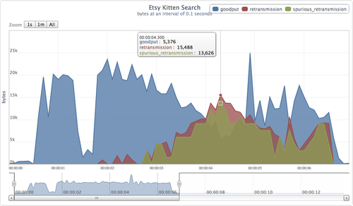
No problem… domain shard all the things!
Duplicate (spurious) data packets lead to poor connection “goodput”
Congestion control is a bigger problem than you might think. Especially in emerging markets where many users are bandwidth+latency limited.
What’s the optimal number of shards?
Trick question, the answer depends on device + network + network weather + page architecture.
Most sites abuse sharding, and hurt themselves… causing congestion, retransmissions, etc.
http://perf.fail/post/96104709544/zealous-sharding-hurts-etsy-performance

Slide 24
“One great metric around that which I enjoy is the fraction of connections created that carry just a single HTTP transaction (and thus make that transaction bear all the overhead). For HTTP/1 74% of our active connections carry just a single transaction - persistent connections just aren't as helpful as we all want. But in HTTP/2 that number plummets to 25%. That's a huge win for overhead reduction.”
Patrick McManus, Mozilla.

Slide 25
Report card: domain sharding
Introduced as a workaround for lack of multiplexing in HTTP/1. UA’s open ~6 connections per origin (6 parallel downloads), and sharding allows us to raise this number to… any number.
Enables (higher) parallelism for HTTP/1.x
No “best” value for number of shards: wasted retransmissions & congestion
Each connection has a resource cost: memory, CPU, etc
Each connection competes with others for bandwidth: poor TCP performance
Complicates our code and applications
Breaks resource prioritization and flow control for HTTP/2
Reduces HPACK compression benefits for HTTP/2
HTTP/1.x: domain sharding is abused, consider limiting use to two shards.
HTTP/2: unnecessary. Negative impact on performance. Eliminate.

Slide 26
Removing domain sharding for HTTP/2
HTTP/2 can coalesce connections on your behalf, if...
TLS certificate is valid for both hosts
Hosts resolve to the same IP
$> openssl s_client -connect google.com:443 |
openssl x509 -noout -text |
grep DNS
DNS:*.google.com, DNS:*.android.com, DNS:*.appengine.google.com, ...
HTTP/1.1 → opens new connection to each origin
HTTP/2 → reuses the same connection for altName origins
Using this technique you can get the best of both worlds with minimal work.

Slide 27

“Reduce requests” → concatenate all the things!
Head of line blocking is expensive, instead of fetching N small assets, let’s fetch fewer but bigger assets.. with same content!
Parallelism workaround for HTTP/1.x
Improved compression due to shared context
Delayed processing and execution
e.g. must wait for entire (CSS, JS) response to arrive
Expensive cache invalidations
single byte update forces full fetch
redundant data transfers on update

Slide 28
Yes, we’ve always had caching… But, we were never able to optimize for “churn” because small requests were too expensive. This is no longer the case.
How expensive are your cache invalidations?
Can you isolate high-velocity code from “stable” code?
Can you assign different expiry times to these resources?
* churn: ratio of bytes (in cache vs new) we have to fetch when pushing an update.

Slide 29
Report card: concatenated assets
Introduced as a workaround for head-of-line blocking in HTTP/1. Concatenation allows us to fetch “multiple files” within one request.
Improves HTTP/1.x performance
May deliver better resource compression
Complicates our code and applications - e.g. extra build steps
Breaks granular caching, updates, and revalidation
Delays resource processing and execution
Forces expensive cache invalidations
HTTP/1.x: use carefully and consider and optimize for invalidation costs (churn).
HTTP/2: avoid*. Ship small granular resources and optimize caching policies.
* Significant wins in compression are the only case where it might be useful.

Slide 30
“Reduce Requests” → inline all the things!
Head of line blocking is expensive, instead of fetching granular resources, just embed them inside others… to avoid requests.
Parallelism workaround for HTTP/1.x
Eliminates full request roundtrip
Inlined resource can’t be cached independently
must duplicate bytes if resource is reused
invalidated if single byte in parent changes
Breaks resource multiplexing and prioritization in HTTP/2
Inlined bytes are shipped with parent’s priority
Inlined bytes can’t be declined by the client

Slide 31


Inlining: because you’ll also need…
GET /product/123
Server: “You asked for /product/123, but you’ll need app.js, product-photo-1.jpg, as well… I promise to deliver these to you. That is, unless you decline or cancel.”
/product/123
/app.js
/product-photo-1.jpg
Inlining is server push. Except, server push has nicer properties:
Delivers granular resources, which can be cached individually
Delivers granular resources, which can be mux’ed and prioritized correctly
Allows the client to opt-in / opt-out and control how and where it is used
Server push is subject to flow control - e.g. “you can only push 5KB”
Server push is optional and can be disabled by the client

Slide 32
Per-stream flow control + server push
Client: “I want first 20KB of photo.jpg”
Server: “Ok, 20KB… pausing stream until you tell me to send more.”
Client: “Send me the rest now.”
GET /product-photo.jpg
/product-photo.jpg
WINDOW_UPDATE
/product-photo.jpg
I want image geometry and preview, and I’ll fetch the rest later...
Flow control allows the client to pause stream delivery, and resume it later
Flow control is a “credit-based” scheme
Sending DATA frames decrements the window
WINDOW_UPDATE frames update the window
http://chimera.labs.oreilly.com/books/1230000000545/ch12.html#_flow_control

Slide 33
Report card: resource inlining
Introduced as a workaround for head-of-line blocking in HTTP/1. Inlining is a latency optimization that eliminates full request roundtrip, and reduces “number of requests” in HTTP/1.
Removes full request roundtrip - i.e. “you’ll need this”
Parallelism workaround for HTTP/1.x
Complicates our workflows, code and applications
Breaks granular caching, updates, and revalidation
Forces frequent and expensive invalidations
HTTP/1.x: use carefully and pay close attention to caching implications.
HTTP/2: replace with server push. The most naive strategy is still strictly better.
* Significant wins in compression are the only case where it might be useful.

Slide 34

HTTP/2 server push instead of inlining...
Implementation and status
Restricted to same-origin resources
Opportunity for servers to become much smarter:
Don’t push on every request
Push based on observed traffic patterns
UA’s iterating on implementation, e.g…
Auto RST_STREAM in-cache resources (works)
Pushing cache revalidations / invalidations? (TBD)
JavaScript API for processing server push? (TBD)

Slide 35
Jetty’s “smart push” is a great strategy...
Server observes incoming traffic
Build a dependency model based on Referer header
e.g. index.html → {style.css, app.js}
Server initiates push for learned dependencies
client → GET index.html
server → push style.css, app.js, index.html
Lots of room for experimentation + innovation!

Slide 36

You... need to think about prioritization
with HTTP/2 the browser is relying on the server to deliver data in an optimal way -- this is critical.

Slide 37
Prioritization is key to optimized rendering...
With HTTP/1.1 browsers “prioritizes” resources by holding a priority queue on the client and taking educated guesses for how to make the best use of available TCP connections… which delays request dispatch.
time
GET index.html
High
Priority
GET style.css
GET hero.jpg
Low
Priority
GET other.jpg
Delay dispatch, because we don’t want to “waste” bandwidth on images, we might have more critical resources, etc...

Slide 38
Prioritization is key to optimized rendering...
With HTTP/2 browsers prioritize requests based on type/context, and immediately dispatch the request as soon as the resource is discovered. The priority is communicated to the server as weights + dependencies.
time
GET index.html
High
Priority
GET style.css
GET hero.jpg
Requests are initiated as soon as each resource is discovered
Low
Priority
GET other.jpg
Responsibility is on the server to deliver the bytes in the right order!

Slide 39
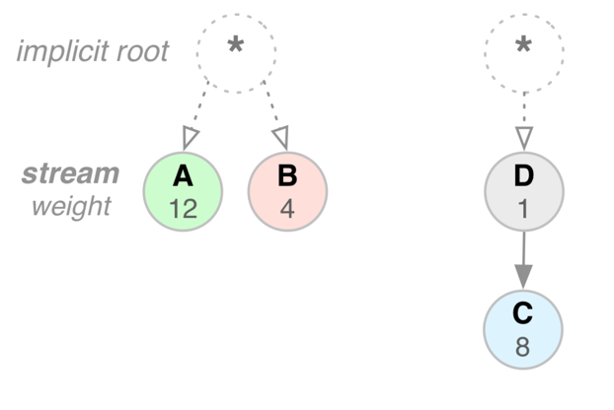
Stream prioritization in HTTP/2...
Each stream can have a weight
[1-256] integer value
Each stream can have a dependency
parent is another stream ID
E.g. style.css (“A”) should get 2/3rd’s of available resources as compared to logo.jpg (“B”)
E.g. product-photo-1.jpg (“D”) should be delivered before product-photo-2.jpg (“C”)
* Prioritization is an advisory hint to the server, it does not provide strict delivery semantics.

Slide 40
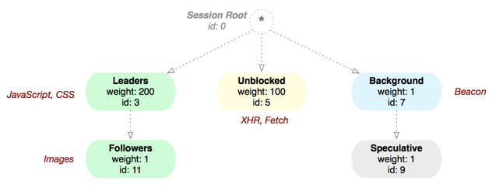
HTTP/2 prioritization in Firefox...
“Leaders” should get 2/3rd of resources, “Unblocked” bulk of the rest
“Leaders” should be prioritized ahead of “Followers” - e.g. HTML/CSS/JS ahead of images.
“Background” tasks should be done… in the background!
http://bitsup.blogspot.se/2015/01/http2-dependency-priorities-in-firefox.html

Slide 41
With HTTP/2 the browser relies on the server to deliver the response data in an optimal way.
It’s not just the number of bytes, or requests per second, but the order in which bytes are delivered. Test your HTTP/2 server very carefully.
Does it respect stream and connection flow control? (MUST)
Does it support dependencies and weights? (MUST)
Does it enable use of server push?

Slide 42
 |  | HTTP/1.x | HTTP/2
Reduce DNS lookups |  | ✓ | ✓
Reuse TCP connections |  | ✓ | ✓
Use a Content Delivery Network |  | ✓ | ✓
Minimize number of HTTP redirects |  | ✓ | ✓
Eliminate unnecessary request bytes |  | ✓ | ✓
Compress assets during transfer |  | ✓ | ✓
Cache resources on the client |  | ✓ | ✓
Eliminate unnecessary resources |  | ✓ | ✓
Apply domain sharding |  | Revisit (max 2) | Remove
Concatenate resources |  | Carefully (caching) | Remove (compression)
Inline resources |  | Carefully (caching) | Remove, use server push
Pick your HTTP/2 server carefully!
… we need better test suites and benchmarks.
Eliminate unnecessary request bytes
Eliminate unnecessary resources
Apply domain sharding
Concatenate resources
Inline resources

Slide 43
Learn more...
hpbn.co/http2
Slides...
bit.ly/http2-opt
+Ilya Grigorik
@igrigorik

